Slide 1

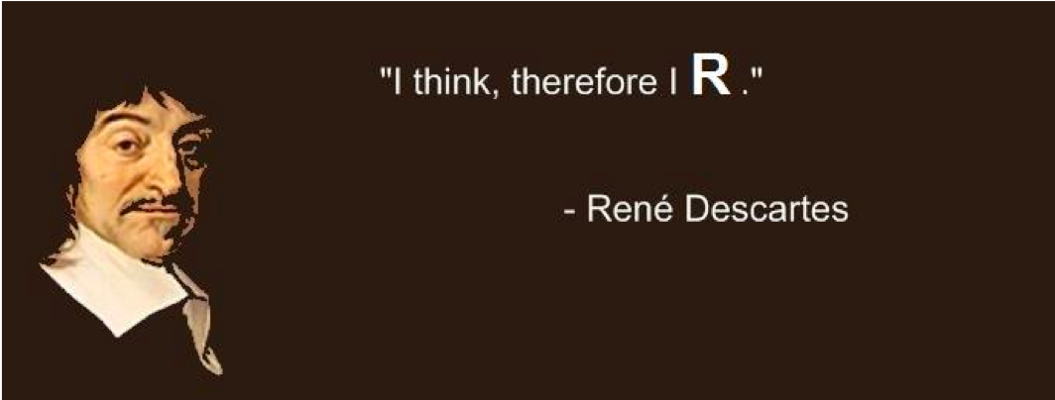
introduction
Huitian Diao (Yolanda)
”You think, therefore you R.”
- René Descartes
References:
Quick-R by DataCamp
R for Beginners by Emmanuel Paradis

Slide 2

Using sticky notes for feedback
“I’ve got a good handle on things…”
“I think I understand but I’m still working through things…”
“I’m not understanding and I’m a little lost right now...”

Slide 3
Get course material
Github
Applied-Bioinformatics
Github
HW
git pull
git push
copy
My local:
Applied-Bioinformatics
My local:
Applied-Bioinformatics

Slide 4
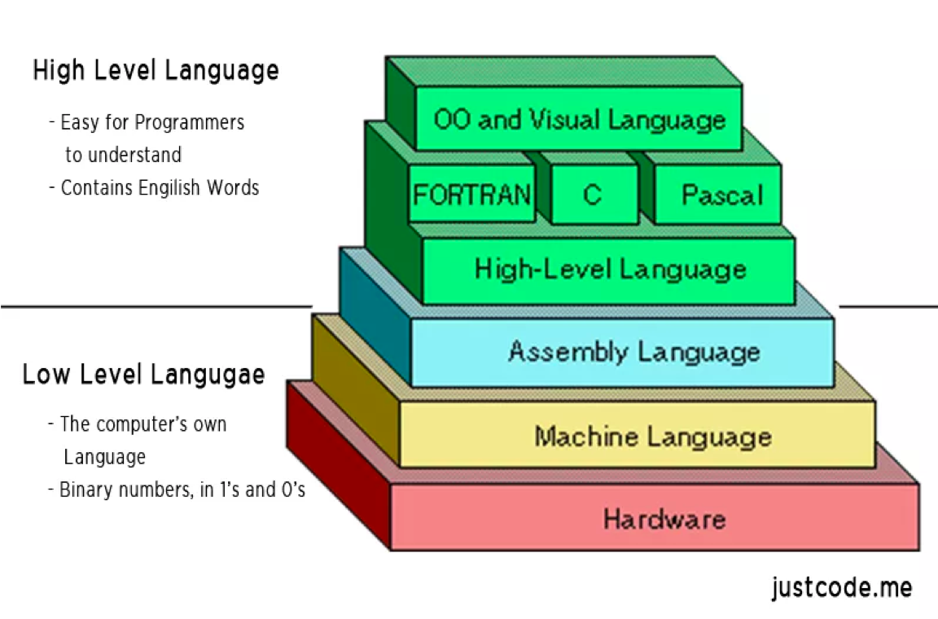
Classification of programming languages
#include<stdio.h>
int main()
{
…
Mov ecx, ebx mov esp, edx
00110101 0111010 10110000 10100100
https://thebittheories.com/levels-of-programming-languages-b6a38a68c0f2

Slide 5
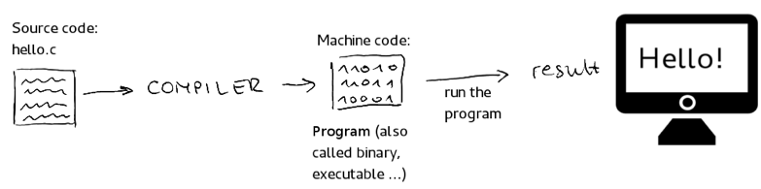

Compiled language vs interpreted language
Compiled
language
C, Java, Julia,
Visual Basic, Fortran,
etc.
High level
language
Interpreted
language
Python, Perl, R,
PHP, JavaScript,
Bash, etc.
http://ikajic.github.io/starting-with-python/#

Slide 6

Why are there so many different languages?
You must have a better reason than filling up a wallpaper to create a new programming language.. Or not???
->
https://www.amazon.com/Programming-Languages-Wall-Wallmonkeys-WM133928/dp/B00PM5TM6Q

Slide 7
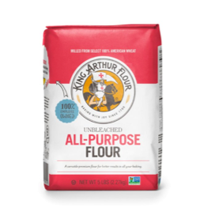
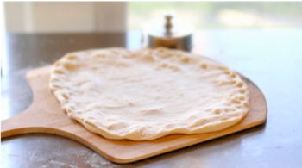
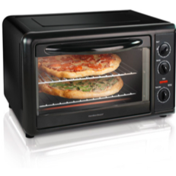
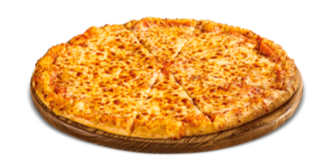
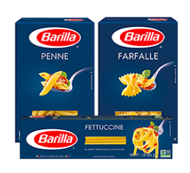
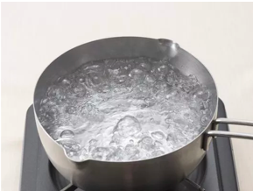
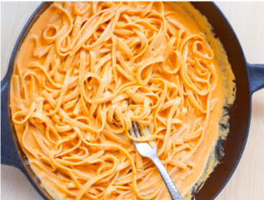
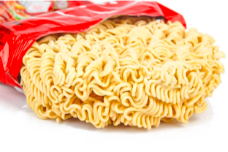
Why are there so many flour based foods???
C++
Compiler
R
Interpreter
Python

Slide 8
Comparison of programming languages used in Bioinformatics
 | Advantages | Disadvantages
R | Open-source, various packages for statistical analysis | Slow
Python | Various libraries data analysis, top machine learning language, good code readability | Slow
C++ | Fast | Long developing time
Java | Fast | Long developing time
Bash | Specifically designed for Unix/Linus shell

Slide 9
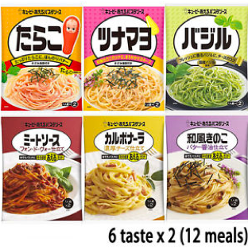
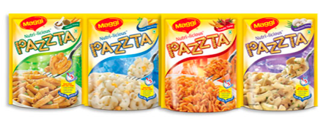
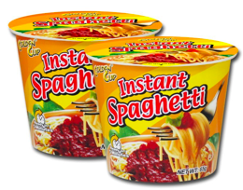
Popular packages in R
Purpose | Package
Learning R | Swirl
Learning R | DataScienceR
Bioinformatics | Bioconductor
Graphic display | ggplot2
Graphic annotation | ggrepel
Phyloenetic tree | ggtree
3D visualization | rgl
Heatmap | pheatmap
Data manipulation | dplyr
Single-cell / other large gene expression datasets | clusterExperiment
Pathway analsis | clusterprofiler
Differential analysis | DEseq2
.
.
.

Slide 10
Contents
R basic syntax
Object
Data types
Vectors
Matrices
Arrays
Data frames
Lists
Factors
Data type conversions
Basic function for objects
Basic data operations
Arithmetic operators
Logical operators
Common math built-in functions
Control structure

Slide 11
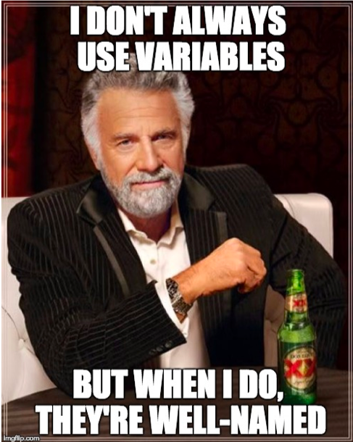
R basic syntax
Value assignment | <-
Print | print()
Comments | # comments
Working directory | getwd()
Set working directory | setwd()
List files in directory | list.files()
Version check | R.Version()
Get help | help()
R style guide by Google

Slide 12
R objects
my.vector <- c(1, 2, 3)
Basic data types | Example
Character | “a”. “qwe”
Numeric | 2. 3.14
Integer | 2L (L indicates integer)
Logical | TRUE FALSE
Complex | 1+4i
Name: my.vector
1
2
3
Content:
Class of object: vector
Data type (storage mode): Numeric

Slide 13
Data types
Vectors | A sequence of data elements of same basic type.
Matrices | Elements of the same type arranges in two-dimensional rectangular layout.
Arrays | Like matrices but can store more than 2 dimensions.
Data frames | Like matrices, but different columns can have different modes.
Lists | An ordered collection of objects. A list allows you to gather a variety of objects.
Factors | A nominal variable
Arrays
Vector
Matrix
Data frames
Factor
(categorical)
1 | 2 | 3
1 | 2 | 3
4 | 5 | 6
7 | 8 | 9
1 | 2 | 3
4 | 5 | 6
7 | 8 | 9
1 | “a” | T
2 | “b” | F
3 | “c” | F
Under 21 | Above 21
List
1 | “a” | c()

Slide 14
Data type conversion
From | To | Function
Vector | One longer vector | c(x, y)
Vector | Matrix | cbind(x, y) rbind(x, y)
Vector | Data frame | Data.frame(x, y)
Matrix | Vector | as.vector()
Matrix | Data frame | as.data.frame(mymatrix)
Data frame | matrix | as.matrix()
List | Vector | unlist()
* | Numeric | as.numeric()
* | Character | as.character()

Slide 15
Basic functions for objects
Type of object | class()
Storage mode | mode()
Names | names()
Structure | str()
Number of elements | length()
Current objects listing | ls()
Remove objects | rm()

Slide 16
Practice 2.1 !
Commends:
<-
print()
getwd()
setwd()
matrix() # Matrix
c() # Vector
factor()
data.frame() # Data frame
str()
class()
Objectives:
Check your working directory, change directory to Unit1-module2-R, and list the files in the folder
Create a vector containing names of 5 states and print it.
Create a matrix with 100 numbers, with 10 column and 10 rows, and print it.
Create a dataframe for experiment animals to record their information.
Name the dataframe's columns.
Make gender of animals a nominal variable and summarize the gender.
Check the structure of your dataframe and the type of elements in your dataframe
#Animal info:
#Names: Fluf1, Fluf2, Fluf3, Fluf4, Fluf5, Fluf6, Fluf7, Fluf8
#Number: 7103, 7104, 7105, 7106, 7107, 7108, 7109, 7110
#Weight: 19, 18, 23, 22, 17, 18, 21, 20
#Treated: TRUE, TRUE, FALSE, FALSE, TRUE, FALSE, TRUE, FALSE
#Gender: Female, Female, Male, Male, Female, Female, Male, Male

Slide 17
Basic data operations
Arithmetic operators
+ | addition
- | subtraction
* | multiplication
/ | division
** or ^ | exponentiation
%% | modulus
%/% | integer division
Logical operator
> >= | Greater Greater or equal
< <= | Less Less or equal
== != | Equal to Not equal to
! | NOT
| | OR
& | AND
isTrue() | If … is true

Slide 18
Common math built-in functions
abs() | Absolute value
sqrt() | Square root
ceiling() | Ceiling(3.457) is 4
floor() | Floor(3.457) is 3
trunc() | Trunc(5.99) is 5
round() | Round(3.457, digits=2) is 3.48
signif() | Signif(3.475, digits=2) is 3.5
sin() cos() tan() | Trigonometric functions
log() log10() | Natural logarithm or commom logarithm
exp() | e^

Slide 19
Control structures: If else
If (condit) {
}
else {
}
If (condit1) {
}
else if (condit2) {
}
else {
}
init
init
condit
FALSE
condit1
FALSE
TRUE
TRUE
If
body
Else body
If
body
condit2
FALSE
TRUE
Else if
body
Else body

Slide 20
Control structures: For and while
for (i in c()) {
…
}
while () {
…
…
}
init
init
i in c()
FALSE
condit
FALSE
TRUE
TRUE
…
…
…

Slide 21
Practice 2.2 !
Commends:
c()
toupper()
class()
logical() # Initialize charcter vector with certain length
for
if... else…
Objectives:
Build a vector containing characters a to e, and another vector containing number 1-6.
Convert the first vector to all upper case.
Concatente the two vectors and check the element type of the all the vectors created.
Use a while loop to print out all the numbers that can be divided by 3 from 1 to 100 and count how many of them exist.
3. Nutella needs to be fed with 5 grams of rodent diet everyday.
Please create a for loop that will take a vector containing the weight of food that is given, and print out if the food is enough / more than enough / too little.
Create a vector with TRUE or FALSE for the output, if the food is enough or more then TRUE, else FALSE.
# Initialize empty vector of certain length -- e.g.: character(10) # create a empty vector of 10 elements with data type character
# Weight of rodent diet given to Nutella this week
food.weight <- c(7,3,5,6,10,5,6)

Slide 22
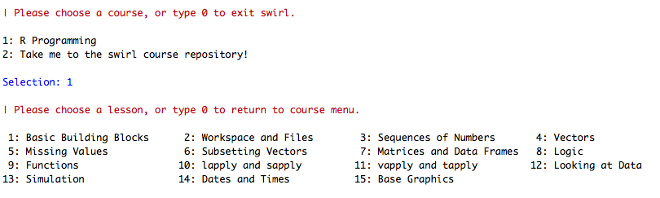
Assignment: Learn R by your self with Swirl
https://swirlstats.com/students.html
Review

